Slide 1
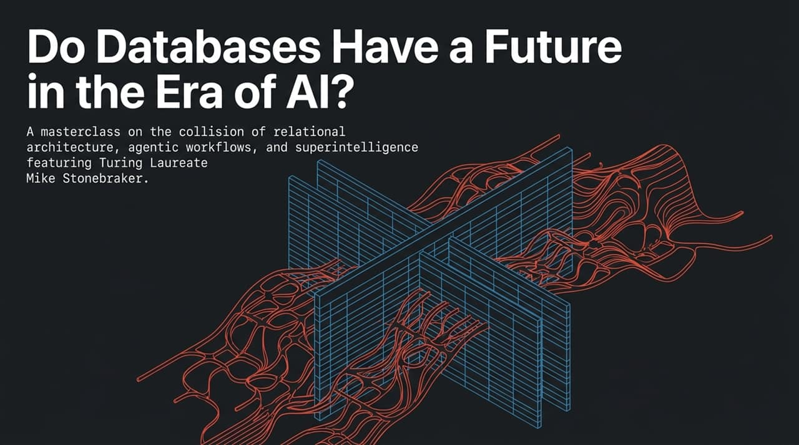
Notes:
Opening Hook: Welcome, everyone. Today we are tackling a fundamental architectural question: In an era dominated by large language models, agentic workflows, and the push toward superintelligence, do traditional database systems still have a future?
Context & Core Debate: Many in AI argue that end-to-end differentiable neural models will simply compress and absorb all human knowledge, rendering structured relational storage obsolete. However, Turing Award Laureate Mike Stonebraker argues that real-world enterprise operations cannot function on probabilistic text alone.
Roadmap: Over the next 16 slides, we will examine the collision between relational architecture and foundation models. We will explore the "Dark Matter" of enterprise data, why current AI agents fail in production, how database principles like ACID durability and Sagas save agentic systems, and how superintelligence might finally realize OS-level database integration.
Key Takeaway: The question isn't whether databases will survive, but how database theory must form the bedrock of reliable AI infrastructure.
https://www.youtube.com/watch?v=kgtZKAVWVEs

Slide 2
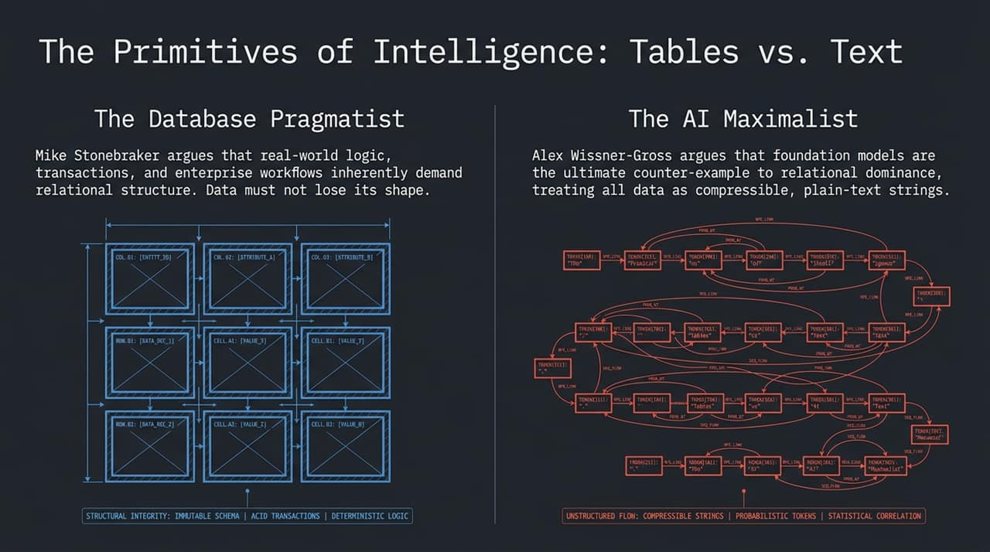
Notes:
Visual Breakdown: On the left, we have the Database Pragmatist worldview—a clean, deterministic relational matrix with immutable schemas, ACID guarantees, and precise relational joins. On the right, we have the AI Maximalist worldview—a high-dimensional, fluid web of compressible strings, subword tokens, and statistical correlations.
The Philosophical Rift:
The AI Maximalist View (Wissner-Gross): Intelligence is compressed knowledge. Foundation models process plain-text strings (Unicode/BPE tokens), treating all data as fluid, differentiable streams.
The Database Pragmatist View (Stonebraker): Real-world business logic—financial ledgers, supply chains, user permissions—inherently demands rigid relational structure. Converting tables into flat text streams destroys their essential mathematical properties.
The Technical Danger: When AI harnesses attempt to perform "joins" by feeding raw tabular data into an LLM context window, it conducts a text-to-text join. This process is inherently lossy, probabilistic, and vulnerable to hallucination.
Call to Action/Transition: To understand why flat text fails for complex systems, we must look below the surface of public web data.

Slide 3
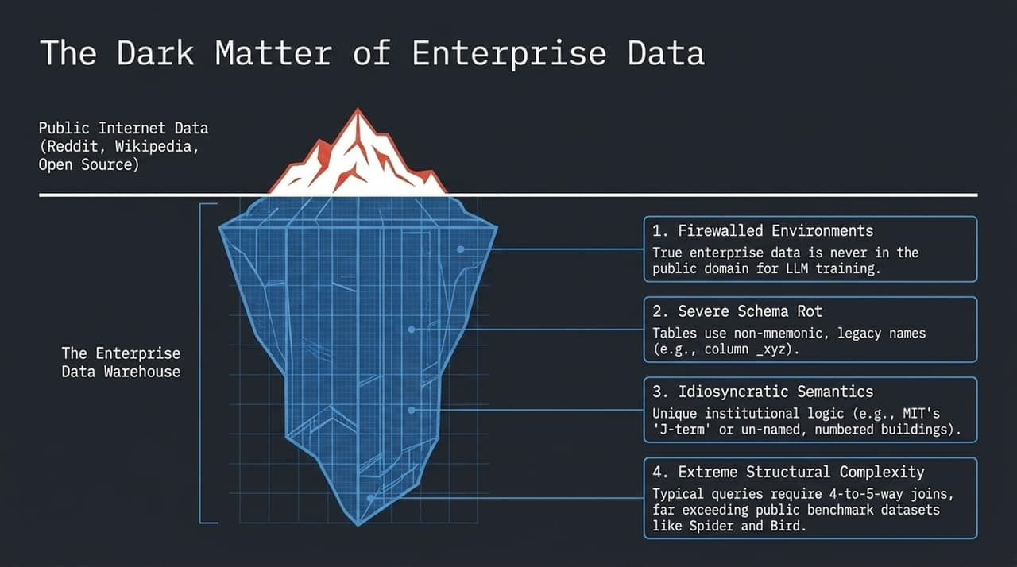
Notes:
The Iceberg Metaphor: Public internet data—Reddit, Wikipedia, GitHub—is just the tip of the iceberg that trains foundation models like Claude or GPT. The vast majority of global data is "Dark Matter"—closely held, firewalled enterprise data warehouses.
Four Core Enterprise Obstacles:
Firewalled Environments: Proprietary data is never exposed to public internet scrapers for LLM pre-training.
Severe Schema Rot: Legacy production tables do not use neat names like employee or salary. They use non-mnemonic names like col_xyz_7 or tbl_p_q4, reflecting decades of technical debt.
Idiosyncratic Semantics: Organizations rely on hyper-local domain knowledge. (e.g., MIT identifying buildings by numbers rather than names, or using terms like "J-term").
Extreme Structural Complexity: Benchmark tests like Spider or Bird use simple student queries. Enterprise systems routinely execute 4- to 5-way joins across thousands of tables.
Conclusion: Foundation models cannot reliably navigate enterprise data off-the-shelf because they lack exposure to this dark matter during pre-training.

Slide 4
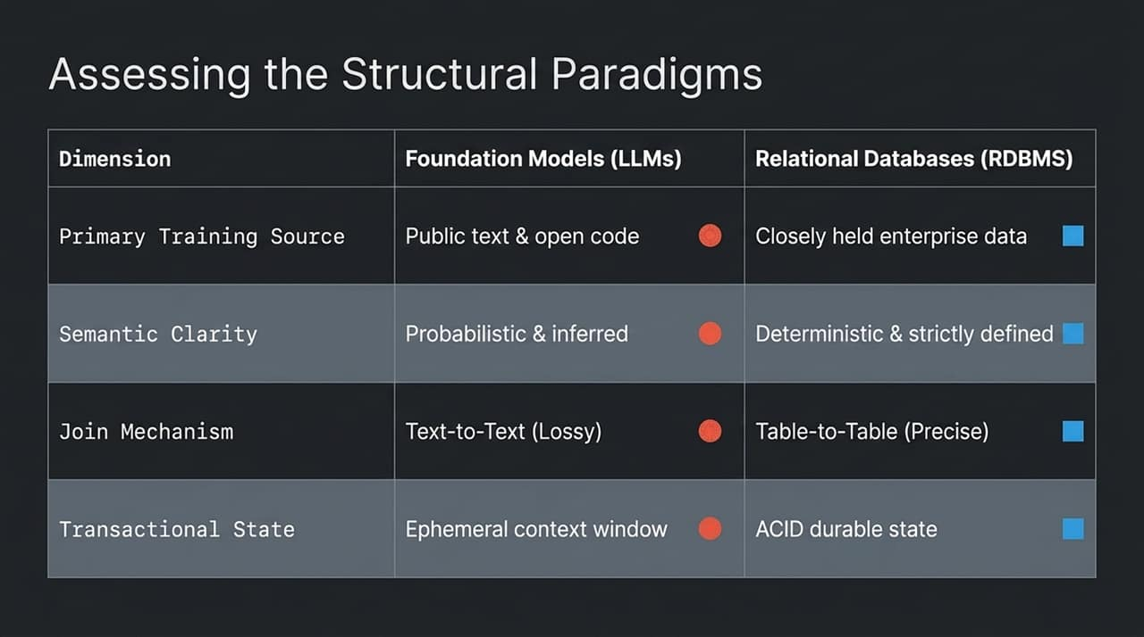
Notes:
Comparative Breakdown: Let's compare Foundation Models and Relational Database Management Systems across four core dimensions:
Training/Source: LLMs rely on public internet text and open-source code; RDBMSs hold internal enterprise facts behind firewalls.
Semantic Clarity: LLMs infer meaning probabilistically (what token comes next?); RDBMSs enforce strictly defined, deterministic constraints.
Join Mechanism: LLMs perform lossy text-to-text synthesis; RDBMSs execute exact table-to-table relational operations.
Transactional State: LLMs operate within an ephemeral context window; RDBMSs maintain durable, ACID-compliant state.
Strategic Insight: You cannot replace a deterministic ACID state engine with a probabilistic token predictor when accuracy and transactional safety are paramount.

Slide 5
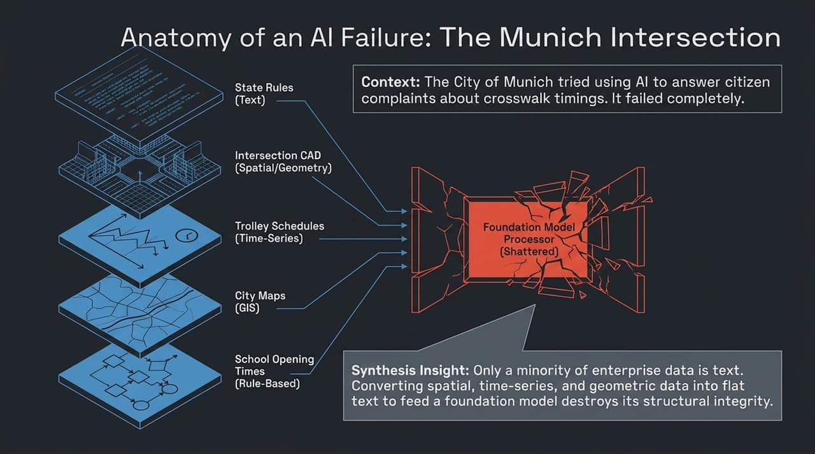
Notes:
Real-World Case Study: To illustrate this structural divide, consider a real project from the City of Munich’s Department of Transportation. They attempted to build an AI agent system to answer citizen complaints regarding crosswalk timing.
The Data Heterogeneity Problem: Answering a simple complaint ("I don't have enough time to cross") requires merging 5 disparate data modalities:
City/State Rules & Regulations (Unstructured Text).
Intersection Blueprints (Spatial/CAD Geometry).
Trolley Schedules (Time-Series).
City Maps & Locations (GIS Data).
School Opening Times (Rule-Based Timetables).
Why Traditional LLM Agents Failed: The agent framework converted spatial CAD, time-series, and GIS data into flat text strings to feed the LLM. Flattening multi-modal geometric and temporal data destroyed the structural integrity needed to compute the correct light sequence.
Lesson: Enterprise AI cannot flatten structured data into plain text. It must retain relational and spatial representations natively.

Slide 6
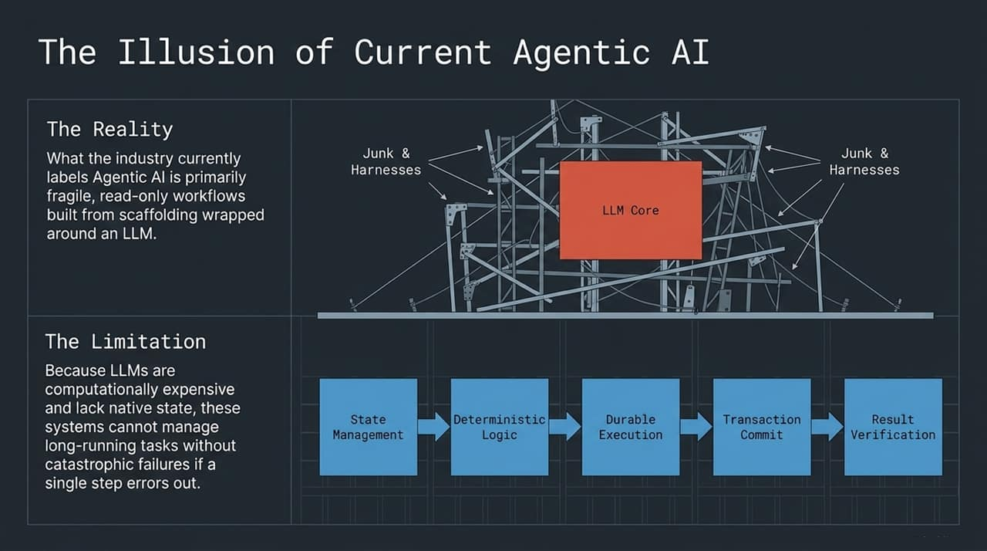
Notes:
The Industry Reality: Today, everyone claims to be building "Agentic AI." In practice, most current agents are merely fragile, read-only scaffolding wrapped around an LLM core.
Visual Critique: The graphic illustrates the reality: a central LLM core surrounded by makeshift "junk and harnesses"—prompt templates, API wrappers, and ad-hoc retries.
The Computational Bottleneck: LLMs are computationally expensive and lack native state management. When an agent executes a multi-step, long-running workflow, a single network timeout, rate limit, or model hallucination causes the entire system to crash without a recovery mechanism.
The Missing Architecture: Reliable agentic systems require Durable Execution: State Management, Deterministic Logic, Durable Execution, Transaction Commits, and Result Verification.

Slide 7
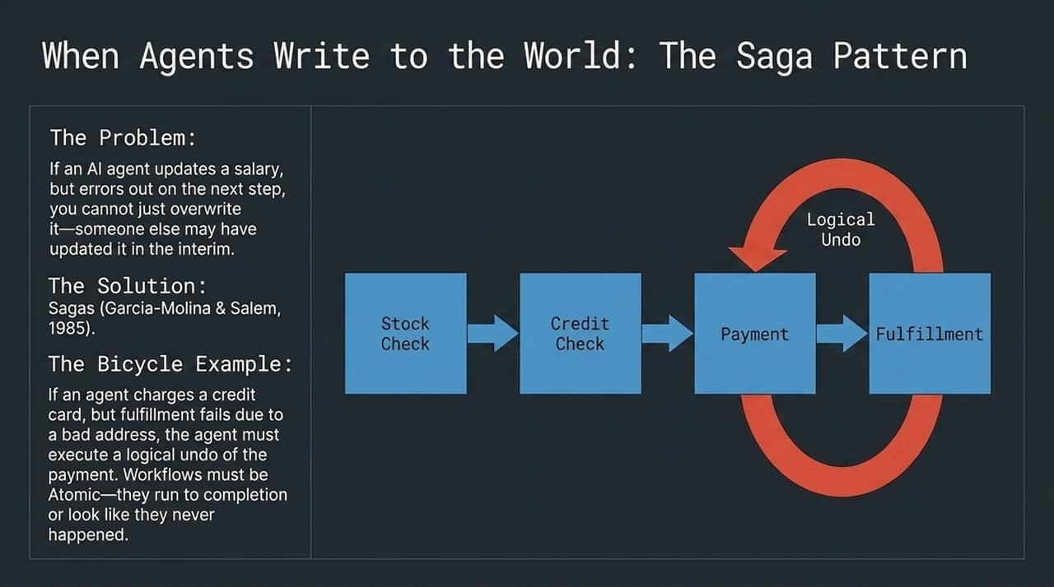
Notes:
The Write Problem: Read-only agents are safe, but useful agents must write to the real world—updating payroll, placing orders, and modifying inventory. What happens when an agent mid-workflow errors out after committing a step?
Why Standard Rollbacks Fail: You cannot simply overwrite the database state to "undo" step 2. In an active enterprise system, another process or user may have updated that exact row in the interim.
The Solution — Sagas (Garcia-Molina & Salem, 1985):
Decades ago, database theorists solved distributed long-running operations using Sagas.
A Saga manages a sequence of local transactions. If a downstream step fails, it executes a series of Logical Undos (compensating transactions) in reverse order.
The E-Commerce Bicycle Example:
Stock Check $→$2. Credit Check $→$3. Process Payment $→$4. Fulfillment.
If Fulfillment fails due to an invalid shipping address, the agent cannot just crash. It must trigger a compensating transaction (Logical Undo) to refund the credit card charge.
Core Principle: Workflows must be Atomic—they run fully to completion or leave the system as if they never happened.

Slide 8
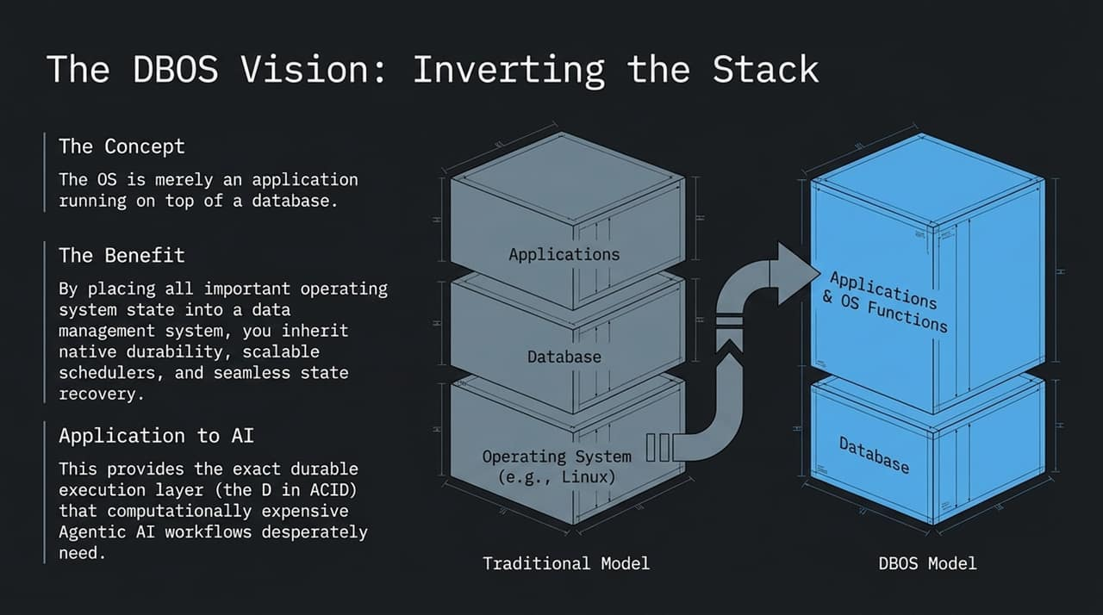
Notes:
Traditional Architecture: Traditionally, operating systems (e.g., Linux) sit at the base, running databases as user-space applications.
The DBOS Paradigm Shift: DBOS (Database Operating System) inverts this stack. The Operating System itself becomes an application running on top of a high-performance database kernel.
Why Invert the Stack? By storing OS state, thread scheduling, file metadata, and process states inside a database, the operating system natively inherits:
Native state durability.
Fault tolerance and effortless recovery.
High-scalability distributed scheduling.
Relevance to AI: This delivers the exact Durable Execution layer (the 'D' in ACID) required for long-running, computationally expensive agentic AI workflows.

Slide 9
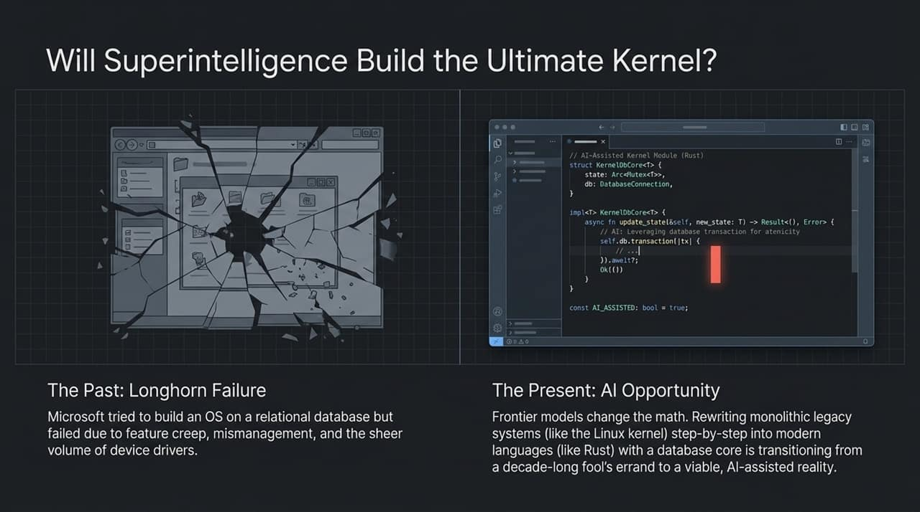
Notes:
Historical Context (Microsoft Longhorn): In the early 2000s, Microsoft attempted to rebuild Windows (Longhorn) on a relational storage engine. It failed due to feature creep, management challenges, and the burden of maintaining thousands of hardware device drivers.
The Present Opportunity: Frontier AI models shift the engineering economics. Rewriting monolithic legacy kernels (like Linux) into memory-safe languages (like Rust) with a database core was once a multi-decade impossible project.
AI-Assisted Kernel Development: AI can systematically refactor legacy code bases step-by-step, wrapping state changes inside explicit database transactions (as shown in the code snippet).
Takeaway: AI transforms the realization of a database-backed operating system from a pipe dream into a feasible engineering endeavor.

Slide 10
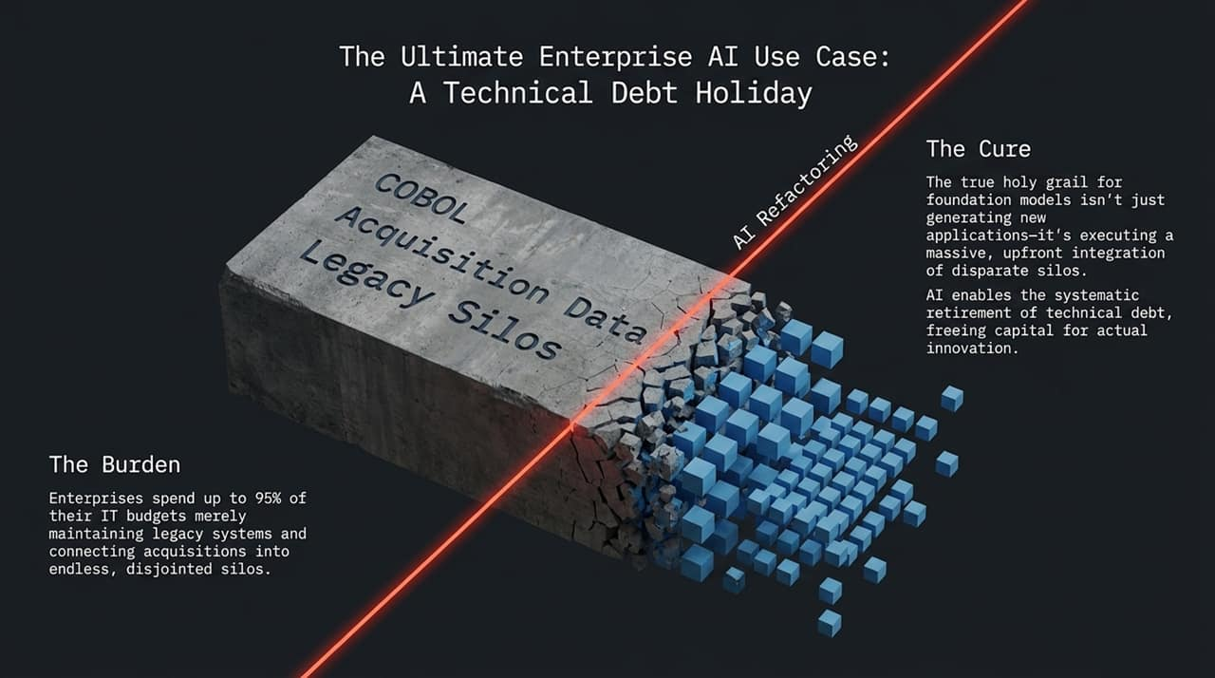
Notes:
The Enterprise Burden: Major enterprises allocate up to 95% of their IT budgets toward maintaining legacy code bases (COBOL, outdated mainframes) and gluing together disparate data silos from past acquisitions.
Silo Accumulation: When an enterprise acquires a company, integrating its systems is often deemed too expensive. Instead, they build another data silo around it, compounding technical debt.
The Holy Grail for AI: The highest-value enterprise application for foundation models is not generating basic marketing copy or simple chat interfaces. It is executing upfront, systematic code refactoring and data integration.
The "Technical Debt Holiday": AI agents can automate the retirement of legacy COBOL and siloing code, freeing up enterprise capital for genuine innovation.

Slide 11
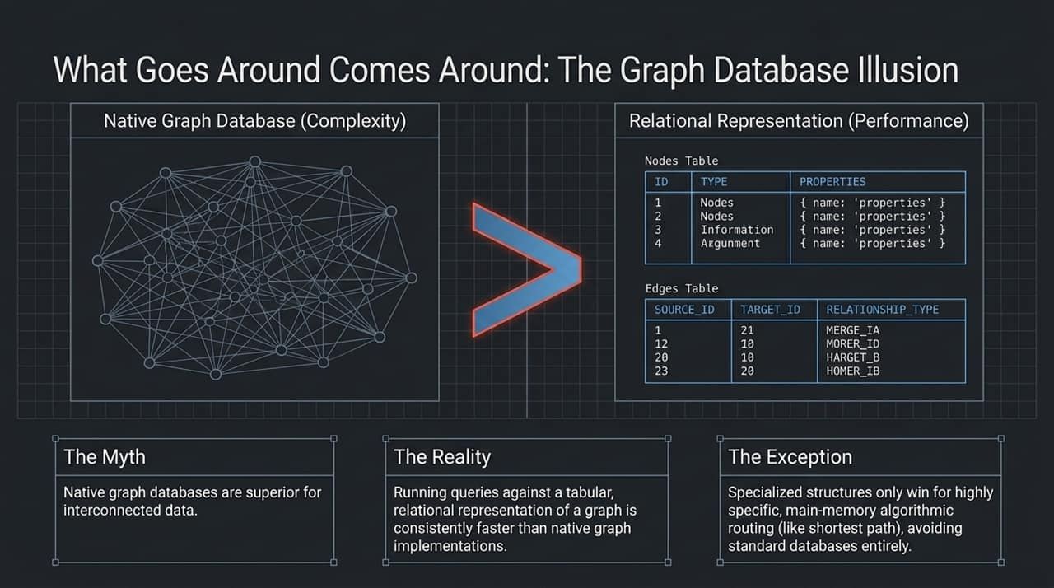
Notes:
The Myth: Graph databases (e.g., Neo4j) are inherently superior for handling complex, interconnected networks.
The Reality: As shown in database research ("What Goes Around Comes Around"), representing a graph via flat relational tables—a Nodes table and an Edges table—consistently outperforms native graph engines for general queries. Systems like Amazon Neptune even implement relational table structures under the hood.
The Performance Exception: Native graph/specialized structures only win in niche edge cases—such as main-memory algorithmic routing (e.g., computing shortest paths).
Takeaway: Relational tabular representations remain the most efficient general-purpose abstraction for interconnected data.

Slide 12
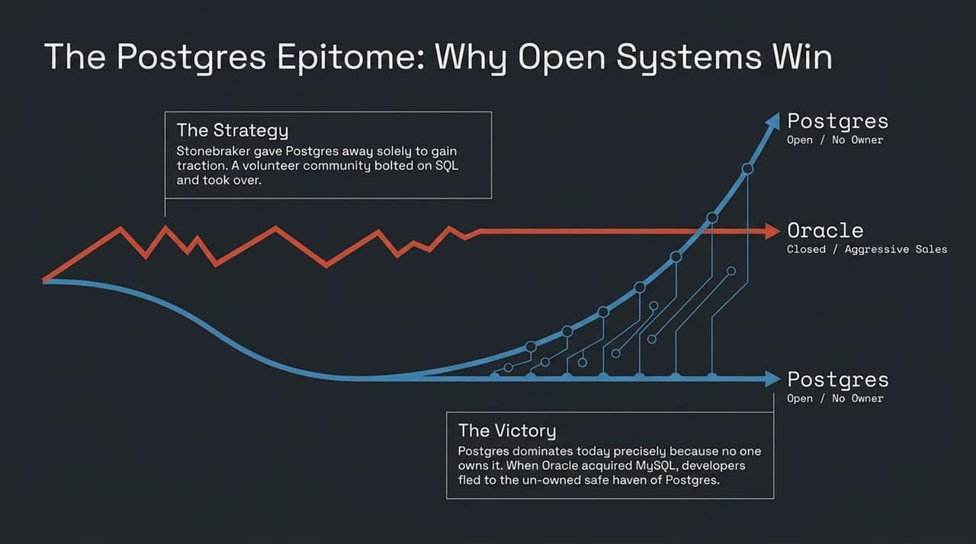
Notes:
Historical Strategy: Mike Stonebraker released the original Postgres source code into the public domain at UC Berkeley to encourage adoption. A volunteer community added SQL support, giving rise to PostgreSQL.
The Victory of Neutral Infrastructure: PostgreSQL dominates modern software development precisely because no single corporate entity owns it. When Oracle acquired MySQL, developers migrated toward PostgreSQL as a safe, neutral standard.
The Open Source Lesson: Proprietary ecosystem lock-in eventually drives developers toward un-owned, community-driven infrastructure.

Slide 13
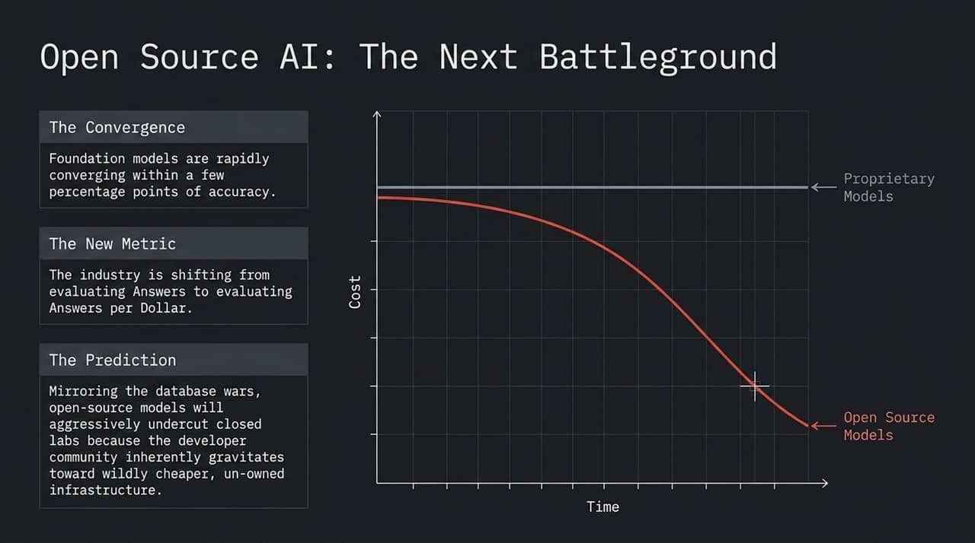
Notes:
Model Convergence: Closed frontier models are rapidly converging in benchmark performance within narrow margins.
The New Evaluation Metric: The industry is shifting from asking "Which model yields the highest benchmark score?" to "Which model yields the most accurate answers per dollar?"
The Prediction: Just as PostgreSQL won the database wars, open-source AI models (and low-cost open architectures) will undercut closed API providers. Developers naturally gravitate toward significantly cheaper, customizable, and un-owned infrastructure.

Slide 14
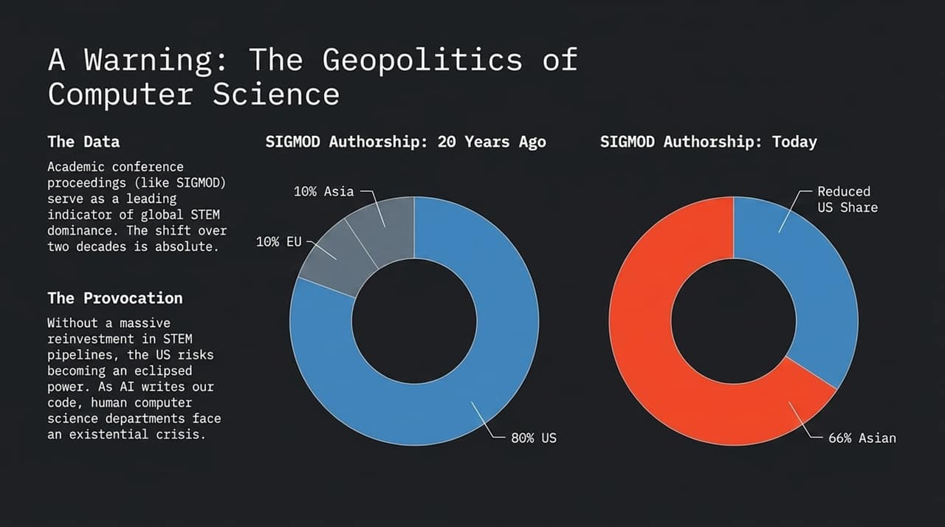
Notes:
Shifting Academic Dominance: Conference authorship (e.g., SIGMOD, NeurIPS) acts as a primary leading indicator for future technological capabilities.
The 20-Year Shift:
20 Years Ago: ~80% of SIGMOD research papers originated from US institutions, with 10% from Europe and 10% from Asia.
Today: Over two-thirds of published papers originate from Asian institutions.
The Provocation: Without significant reinvestment in STEM pipelines, western technological leadership faces erosion. Furthermore, as AI automates routine coding, university Computer Science departments face an identity crisis over what and how to teach.

Slide 15
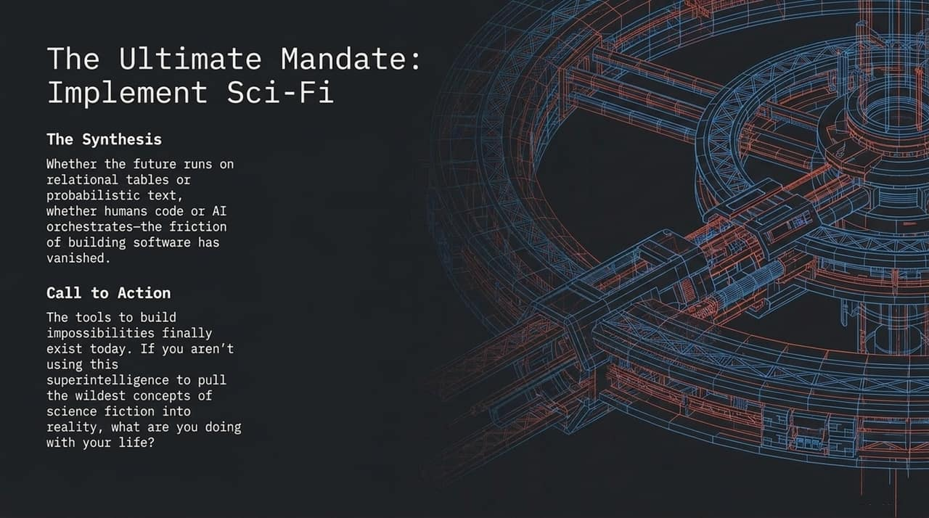
Notes:
Synthesis: Whether future platforms run on relational tables or probabilistic text streams, AI models have drastically lowered the friction of creating software.
The Call to Action: Software development barriers that once required decades of effort are disappearing.
Closing Challenge: The tools to realize previously "impossible" engineering concepts exist today. Developers and researchers should use superintelligence to bring ambitious concepts straight out of science fiction into reality.

Slide 16
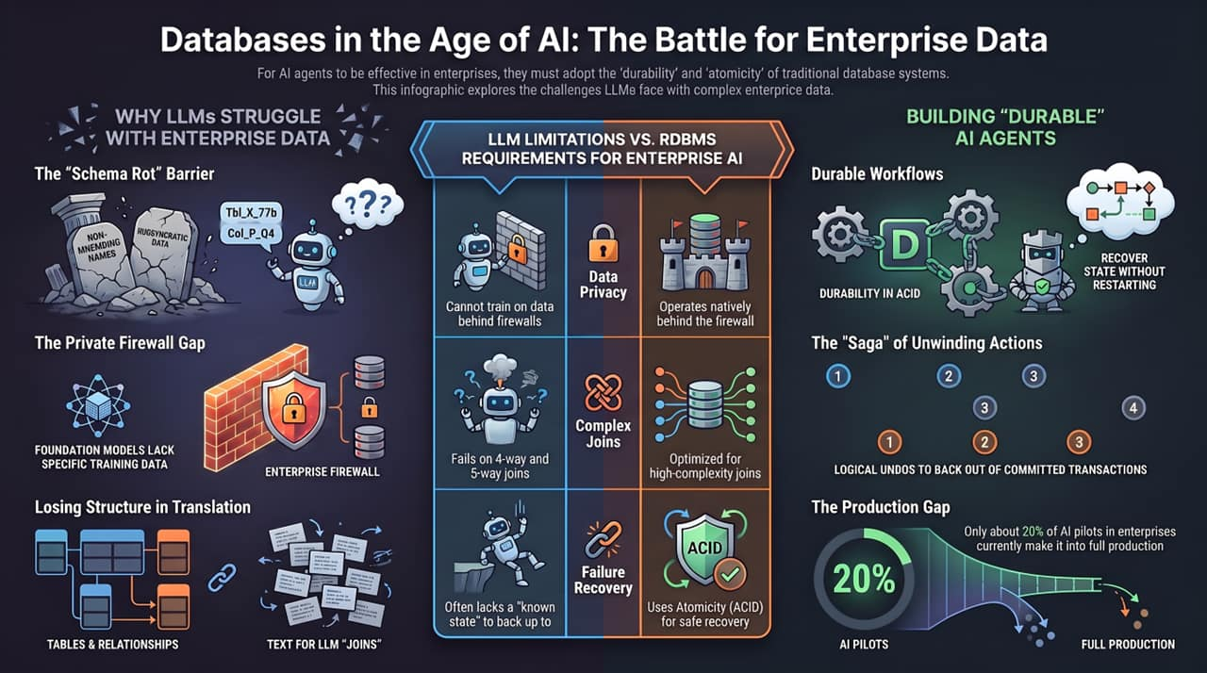
Notes:
Executive Overview: Let me summarize our core findings:
Why LLMs Struggle with Enterprise Data: Enterprise data is hidden behind firewalls, suffers from schema rot, and requires complex multi-way joins that flat text streams ruin.
Building Durable AI Agents: Moving agents from read-only prototypes to reliable production systems requires database fundamentals:
ACID Durability: Saving state at each step so agents can recover from failures.
Sagas & Logical Undos: Safely rewinding committed actions when downstream steps fail.
Closing the Production Gap: Today, only ~20% of enterprise AI pilots reach production due to failures in state management and durability. By incorporating relational database principles, we can bridge this gap and build production-grade agentic systems.

